Slide 1


Modern Operating Systems
Fifth Edition
Chapter 3
Memory Abstractions
Copyright © 2023, 2014, 2008 Pearson Education, Inc. All Rights Reserved

Slide 2
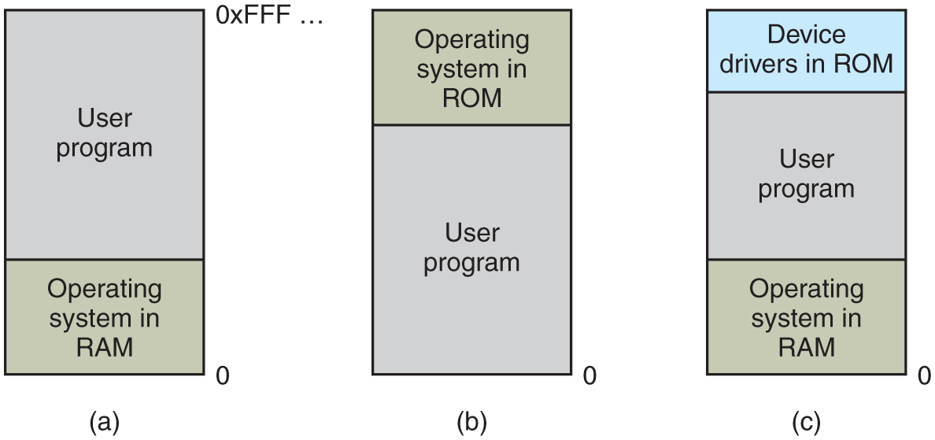
No Memory Abstraction: Monoprogramming
Three simple ways of organizing memory with an operating system and one user process. Other possibilities also exist.
Notes:
Long Description:
Three rectangular blocks are shown. A zero is marked next to the lower right end of all three blocks. Block "a": The block is divided into two segments labeled user program and operating system in R A M. Near the top-right corner of this block, it is labeled 0 x F F F ellipsis. Block b: The block is divided into two segments labeled operating system in R O M and user program. Block c: The block is divided into three segments labeled device drivers in R O M, user program, and operating system in R A M.

Slide 3
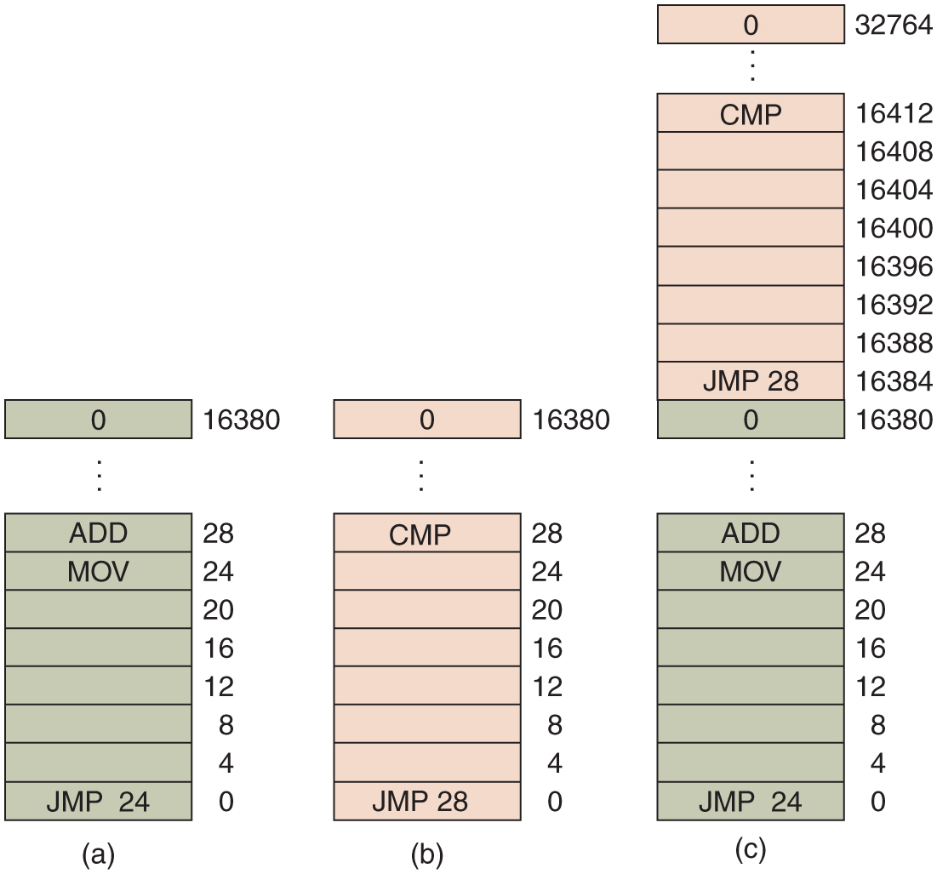
No Memory Abstraction: Multiprogramming
Illustration of the relocation problem.
A 16-KB program.
Another 16-KB program.
The two programs loaded consecutively into memory.
Notes:
Long Description:
Part a: The block consists of 4095 shaded rows with address space labeled from bottom to top as 0, 4, 8, 12, 16, 24, 28, up to 16380. The row having address space 0, 24, 28, and 16380 are labeled J M P 24, M O V, ADD, 0, respectively. Part b: The block consists of 4095 unshaded rows with address space labeled from bottom to top as 0, 4, 8, 12, 16, 20, 24, 28, up to 16380. The row having address space 0, 28, and 16380 are labeled J M P 28, C M P, and 0, respectively. Part c: The block consists of 8191 rows with address space labeled from bottom to top as 0, 4, 8, 12, 16, 20, 24, 28, up to 16380, and then 16384, 16388, 16392, 16396, 16400, 16408, 16412, upto 32764. The rows having address space 0, 24, 28, 16380, 16384, 16412, and 32764 are labeled as follows: J M P 24, M O V, ADD, 0, J M P 28, C M P, and 0. Half of the number of rows from the bottom is shaded.

Slide 4
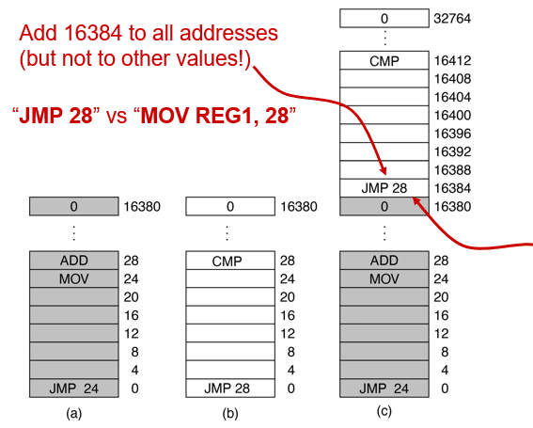
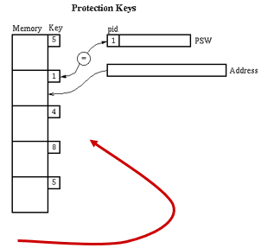
No Memory Abstraction: Multiprogramming
Naive approach:
Move each program to a dedicated region
Problems:
Relocation
Load-time?
Protection
Memory keys?
Figure 3.2 Relocation problem. Two 16 K B programs loaded consecutively into memory.
Notes:
Long Description1:
The first illustration is labeled as a in parenthesis. It shows a grey rectangle with 0 written on it and labeled as 1 6 3 8 0 on the right. Vertical three dots follows the rectangle. Below the dots, there is a rectangle divided into 8 sections from top to bottom. ADD and M O V is written on the top two sections while J M P 24 is written on the bottom section. The labelings of each section from top to bottom on the right side are 28, 24, 20, 16, 12, 8, 4, and 0. The second illustration is labeled as b in parenthesis. It shows a rectangle with 0 written on it and labeled as 1 6 3 8 0 on the right. Vertical three dots follows the rectangle. Below the dots, there is a rectangle divided into 8 sections from top to bottom. C M P is written on the top section while J M P 28 is written on the bottom section. The labelings of each section from top to bottom on the right side are 28, 24, 20, 16, 12, 8, 4, and 0. The third illustration is labeled as c in parenthesis. It shows a rectangle with 0 written on it and labeled as 3 2 7 6 4 on the right. Vertical three dots follows the rectangle. Below the dots, there is a rectangle divided into 8 sections from top to bottom. C M P is written on the top section while J M P 28 and 0 are written on the bottom two sections. The labelings of each section from top to bottom on the right side are 1 6 4 1 2, 1 6 4 0 8, 1 6 4 0 4, 1 6 4 0 0, 1 6 3 9 6, 1 6 3 9 2, 1 6 3 8 8, 1 6 3 8 4, and 1 6 3 8 0. Two squiggly arrows point from opposite direction toward the section in which J M P 28 is written. Vertical three dots follows the rectangle. Below the dots, there is a rectangle divided into 8 sections from top to bottom. ADD and M O V is written on the top two sections while J M P 24 is written on the bottom section. The labelings of each section from top to bottom on the right side are 28, 24, 20, 16, 12, 8, 4, and 0.
Long Description2:
The left part of the illustration shows memory and key. Memory are shown by five square boxes while keys are labeled for each box from top to bottom as 5, 1, 4, 8, and 5. The right part of the illustration has two rectangles. The first rectangle is labeled as P S W. It also has a section labeled as p i d 1. It is connected to key 1 of left part with the help of a pointer. The second rectangle is labeled as address. It is shown by a pointer pointing to memory of the left part of the illustration.

Slide 5
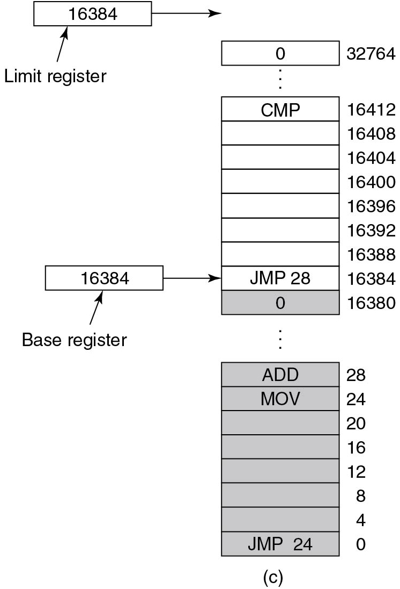
Address Spaces
Base Register: starting address in memory
Limit Register: upper bound of address space
Limit Register
Base Register
Notes:
Long Description1:
The block consists of 8191 rows having address space labeled from bottom to top as 0, 4, 8, 12, 16, 20, 24, 28, up to 16380, and then 16384, 16388, 16392, 16396, 16400, 16404, 16408, 16412, up to 32764. The rows 0, 4, 8, 12, 16, 20, 24, 28, 16380, 16384, 16412, and 32764 are labeled J M P 24, MOV, ADD, 0, J M P 28, C M P and 0, respectively. Half of the number of rows from the bottom are shaded. The limit register with address space 16384 points above the top row of the block and the base register with address space 16384 points to the row labeled J M P 28.
Long Description2:
The code from top to bottom is as follows.
IF left parenthesis Addr is greater than LIMIT right parenthesis implies NOT OKAY
IF left parenthesis BASE plus Addr is less than BASE right parenthesis implies NOT OKAY.

Slide 6

Memory Abstraction
Base register operates dynamic relocation
Limit register enforces protection
Limit Register
Base Register
What’s checked when MOV Reg1, Addr is executed?
Notes:
Long Description1:
The block consists of 8191 rows having address space labeled from bottom to top as 0, 4, 8, 12, 16, 20, 24, 28, up to 16380, and then 16384, 16388, 16392, 16396, 16400, 16404, 16408, 16412, up to 32764. The rows 0, 4, 8, 12, 16, 20, 24, 28, 16380, 16384, 16412, and 32764 are labeled J M P 24, MOV, ADD, 0, J M P 28, C M P and 0, respectively. Half of the number of rows from the bottom are shaded. The limit register with address space 16384 points above the top row of the block and the base register with address space 16384 points to the row labeled J M P 28.
Long Description2:
The code from top to bottom is as follows.
IF left parenthesis Addr is greater than LIMIT right parenthesis implies NOT OKAY
IF left parenthesis BASE plus Addr is less than BASE right parenthesis implies NOT OKAY.

Slide 7
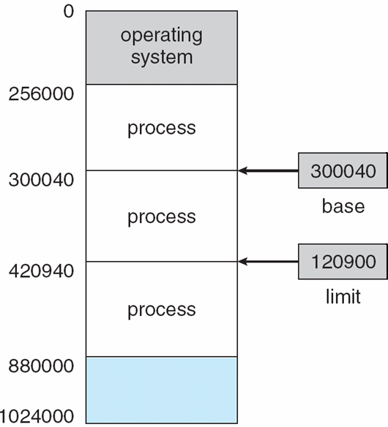
Base and Limit Registers
A pair of base and limit registers define the logical address space
CPU must check every memory access generated in user mode
Each access must be between base and limit for that user
base
limit

Slide 8
Hardware Address Protection

Slide 9



Binding of Instructions and Data to Memory
Address binding of instructions and data to memory addresses can happen at three different stages.
Compile time
If memory location known ahead of time, absolute code can be generated.
Must recompile code if starting location changes.
Load Time
Must generate relocatable code if memory location is not known at compile time
Execution time
If the process’s memory location can be moved during execution, binding is delayed until runtime.
Needs hardware support for address maps (e.g., base and limit registers)

Slide 10
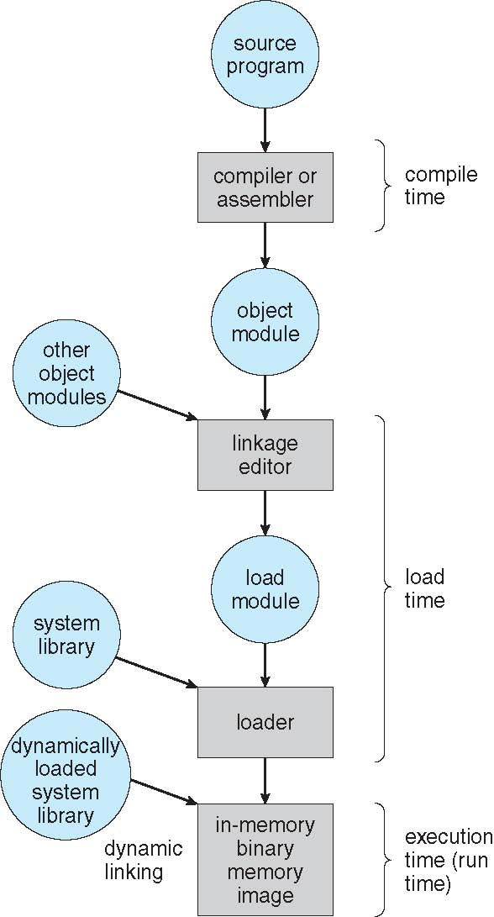
Multistep Processing of a User Program

Slide 11
Memory-Management Unit (MMU)
Hardware device
Maps virtual to physical address at run time
Many methods possible
Consider a scheme where the relocation register’s value is added to every address generated by a user process when sent to memory
Base register now called relocation register*
User programs deal with logical addresses; they never see real physical addresses
Execution-time binding occurs when references are made to location in memory
Logical address bound to physical addresses
*The MS-DOS on Intel 80x86 used 4 relocation registers!

Slide 12
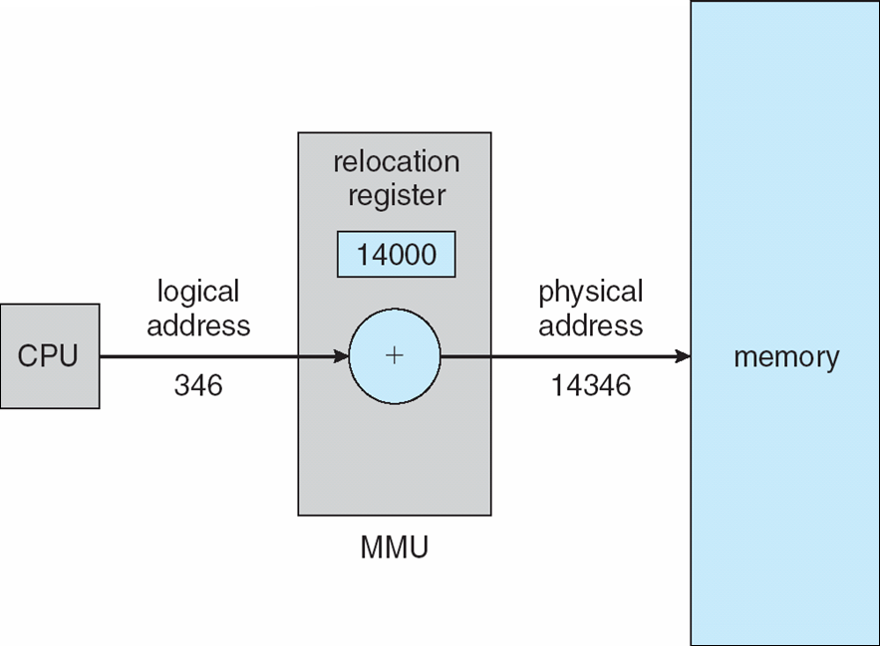
Dynamic relocation using a relocation register
Routine not loaded until called; better memory utilization
Routines kept on disk in relocatable load format
Useful when large amounts of code are needed to handle infrequent cases

Slide 13
Dynamic Relocation: Implementation
No special support from the OS is required!
Implemented through program design
OS can help by providing libraries to implement dynamic loading

Slide 14



Static vs. Dynamic Linking
Static Linking
Loader helps create
+
System Libraries
Program Code
Binary Program Image
Dynamic Linking
runs code
stub (code)
links at execution time
Binary Program Image
Program Code
System Libraries

Slide 15
Dynamic Linking (Shared Libraries) Process
Stub used to locate the appropriate library routine in-memory
Code stub replaces itself with the address of the routine and executes the routine
OS checks if routine is in process’s memory space
If not in address space, adds to address space

Slide 16
Dynamic Linking (Shared Libraries) Benefits
Particularly useful for libraries (shared code)
Updating system libraries is more efficient/easier
Version numbers/names may be needed

Slide 17
What If We Run Out of Memory?
Process Swapping (simplest solution)
Bring in entire process -> run it -> eventually put it back on disk/SSD
Idle processes don’t take up memory when not running
Alternatively: virtual memory -> We will discuss this later!

Slide 18
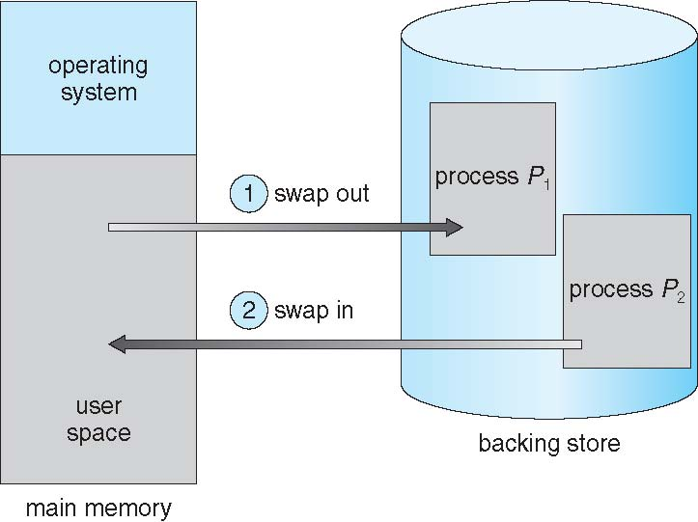
Swapping
A process can be swapped temporarily out of memory to a backing store, and then brought back into memory for continued execution
Total physical memory space of processes can exceed physical memory
Backing store: fast disk large enough to accommodate copies of all memory images for all users

Slide 19
Swapping (Cont.)
Backing store must provide direct access to memory images
Transfer time is a major part of swap time; total transfer time is directly proportional to the amount of memory swapped

Slide 20


Swapping: More Concepts
Roll out, Roll in
Swapping variant for priority-based scheduling.
Lower-priority process are swapped out so higher-priority process can be loaded and executed
Ready Queue
The system maintains a queue of ready-to-run processes which have memory images on disk.

Slide 21
Swapping (Cont.)
Does the swapped out process need to swap back in to the same physical addresses?
Depends on address binding method
Also consider pending I/O to / from process memory space
Modified versions of swapping are found on many systems (i.e., UNIX, Linux, and Windows)
Swapping usually disabled
Memory demand enables and disables swapping

Slide 22
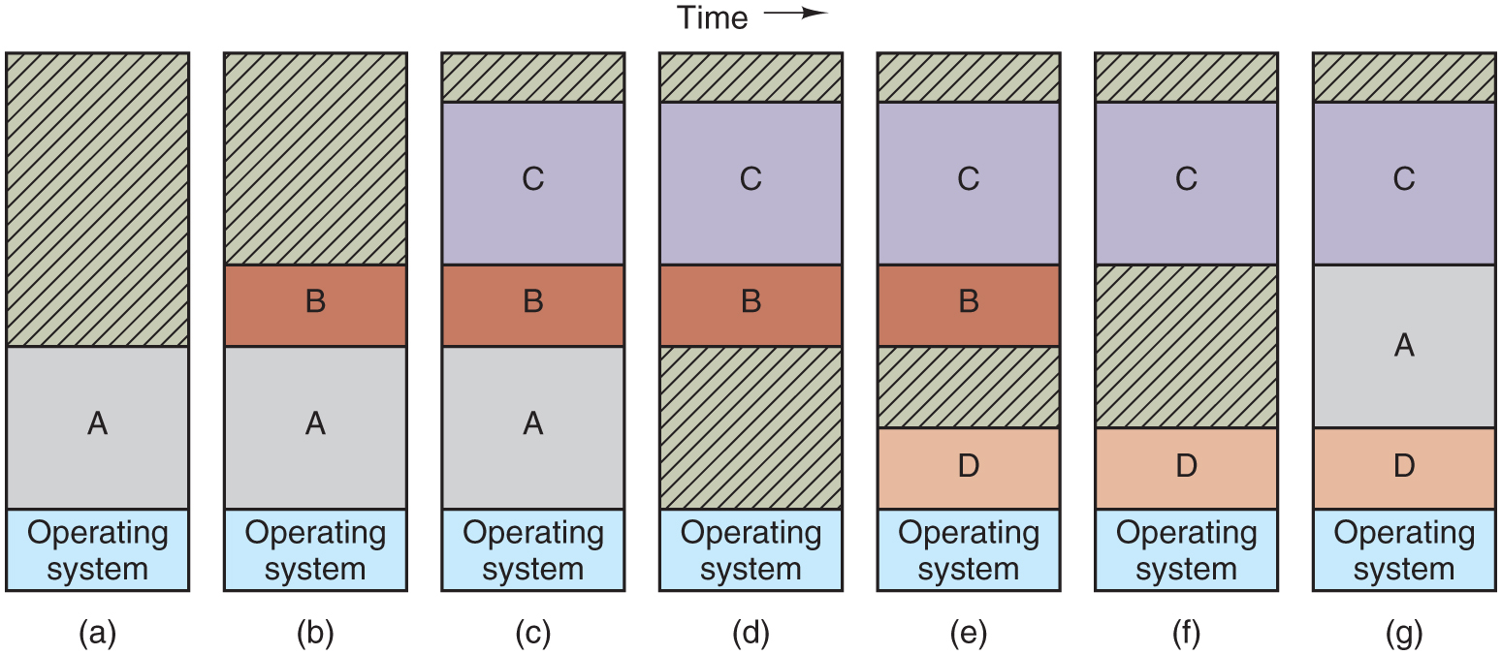
Improvement: Dynamic Partitions and Swapping
Memory allocation changes as processes come into memory and leave it. The shaded regions are unused memory.
Notes:
Long Description:
The figure consists of seven vertical blocks labeled a, b, c, d, e, f and g which are given on time axis. Block "a": The block is divided into three segments with increasing size from the bottom. The bottom segment is labeled operating system and the middle segment is labeled "A". The top segment is the largest and is shaded. Block b: The block is divided into four segments and labeled from top to bottom as follows: Blank, B, A, Operating system. The top segment is shaded. Block c: The block is divided into five segments and labeled from top to bottom as follows: Blank, C, B, A, Operating system. The top segment is shaded. Block d: The block is divided into five segments and labeled from top to bottom as follows: Blank, C, B, blank, Operating system. The first and fourth segments are shaded. Block e: The block is divided into six segments and labeled from top to bottom as follows: Blank, C, B, blank, D, and Operating system. The first and fourth segments are shaded. Block f: The block is divided into five segments and labeled from top to bottom as follows: Blank, C, Blank, D, and Operating system. The first and third segments are shaded. Block g: The block is divided into five segments and labeled from top to bottom as follows: Blank, C, A, D, and Operating system. The first segment is shaded.

Slide 23
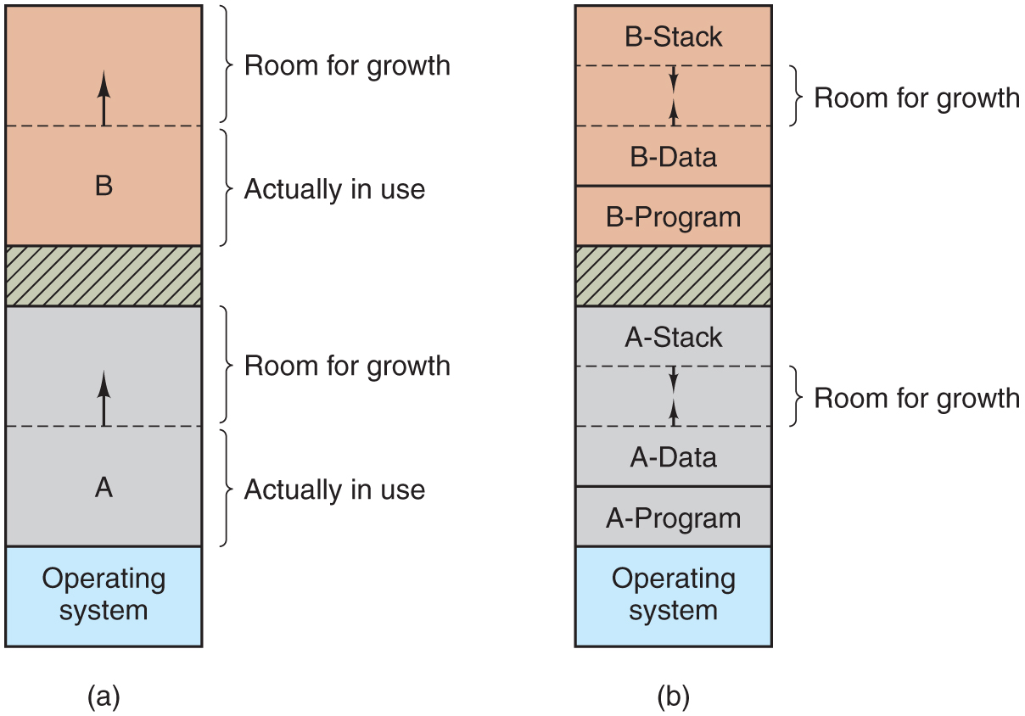
Improvement: Dynamic Partitions and Swapping
Allocating space for a growing data segment:
Allocating space for a growing stack and a growing data segment:
Notes:
Long Description:
Part (a): The block is divided into six segments. The first and second segments, and the fourth and fifth segments from the top are divided by a dashed line. An arrow points upward from the dashed line. The third segment from the top is shaded. The second, fifth and sixth segments are labeled A, B, and Operating system, respectively. The first and fourth segments are marked room for growth while the second and fifth segments are marked actually in use. Part b: The block is divided into 10 segments. The first and second, second and third, sixth and seventh, seventh and eighth segments are divided by a dashed line. Two arrows point toward each other in the second and seventh segment. The segments are labeled from top to bottom as follows: B stack, room for growth, B data, B program, blank, A stack, room for growth, A data, A program, Operating system. The fifth segment is shaded.

Slide 24
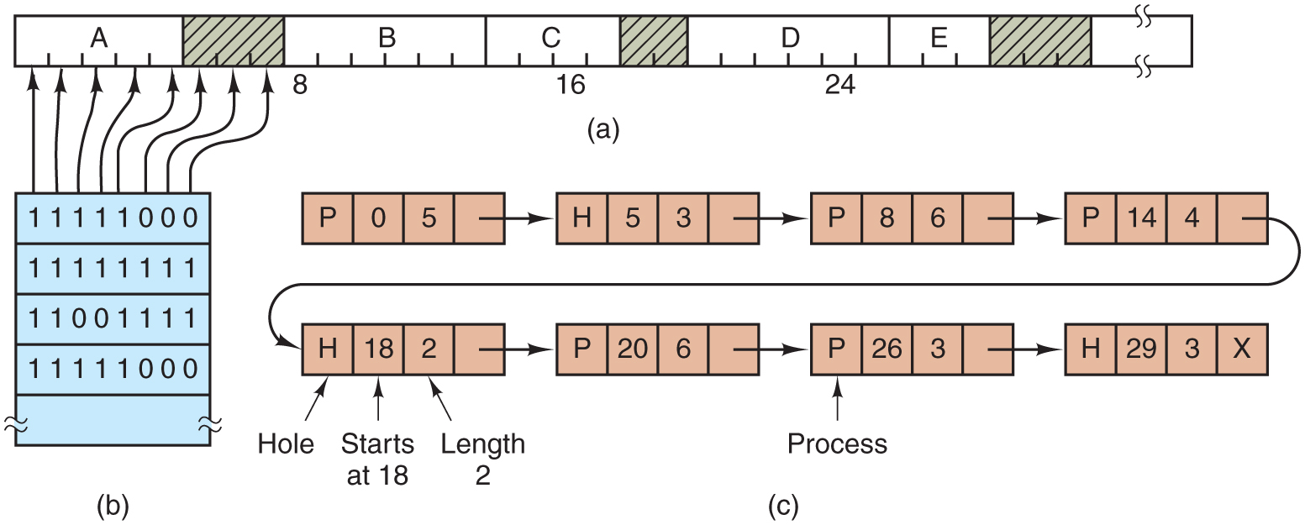
Memory Management: Bitmaps versus Linked Lists
A part of memory with five processes and three holes. The tick marks show the memory allocation units. The shaded regions (0 in the bitmap) are free.
The corresponding bitmap.
The same information as a list.
Notes:
Long Description:
Part (a): The horizontal block with nine segments ranges from 0 to 31 in increments of 1 unit. The segments are labeled from left to right as follows. A, blank, B, C, blank, D, E, blank, blank. The blank segments except the last one are shaded. Part b: A vertical block consisting of five rows is shown below the left end of the previous block. The rows from the bottom are labeled as follows: blank, 1 1 1 1 1 0 0 0, 1 1 0 0 1 1 1 1, 1 1 1 1 1 1 1 1, 1 1 1 1 1 0 0 0. Five arrows are pointed from this block to segment A of the previous block and another three arrows point to the blank segment between A and B.
Part c: Eight horizontal blocks consisting of four segments are shown here. The segments of each block are labeled as follows: Segment 1: P, O, 5 blank. Segment 2: H, 5, 3, blank. Segment 3: P, 8, 6, blank, Segment 4: P, 14, 4, blank. Segment 5: H, 18, 2, blank. Segment 6: P, 20, 6, blank. Segment 7: P, 26, 3, blank. Segment 8: H, 29, 3, X. These blocks are connected from left to right using arrows. Here the P represents process, H represents hole, the second and third column represents starts at and length, respectively.

Slide 25
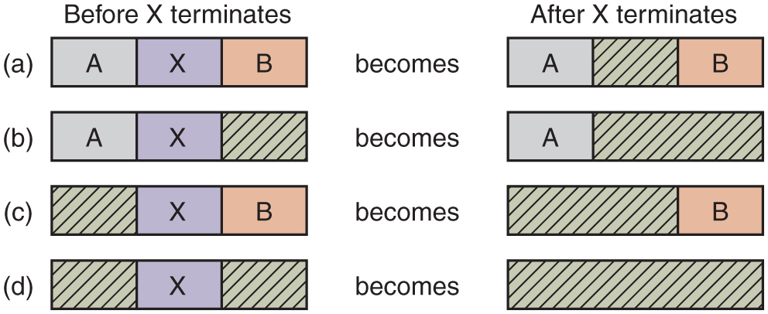
Memory Management with Linked Lists
Four neighbor combinations for the terminating process, X.
Notes:
Long Description:
The figure consists of four parts and eight horizontal blocks. Part "a": The block labeled before X terminates contains 3 sections labeled A, X, B becomes the block labeled After X terminates containing 3 sections labeled A, blank (shaded), B. Part b: The block labeled before X terminates contains 3 sections labeled A, X, blank (shaded) becomes the block labeled After X terminates containing 2 sections labeled A, 2 sections labeled blank (shaded). Part c: The block labeled before X terminates contains 3 sections labeled blank (shaded), X, B becomes the block labeled after X terminates contains 2 sections labeled blank (shaded), B. Part d: The block labeled before X terminates contains 3 sections labeled blank (shaded), X, blank (shaded) becomes the block labeled After X terminates which is completely shaded.

Slide 26
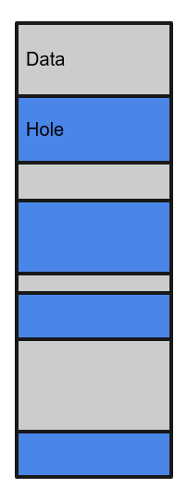
Memory Allocation Schemes
First Fit: Take first fitting hole (M I N I X 3)
Simplest option
Next Fit: Take next fitting hole
Slower than first fit in practice
Best Fit: Take best fitting hole
Prone to fragmentation
Worst Fit: Take worst fitting hole
Poor performance in practice
Quick Fit: Keep holes of different sizes
Poor coalescing performance

Slide 27


Internal vs. External Fragmentation
External Fragmentation: enough overall memory for a request, not enough contiguous memory
Internal Fragmentation: individual processes are ‘wasting’ memory; enough unused memory exists, but it’s hidden within allocated blocks.

Slide 28
Fragmentation (Cont.)
First fit analysis: 0.5 blocks are lost to fragmentation for every block allocated
1/3 may be unusable -> 50-percent rule
Consider that backing store has same fragmentation problems
Reduce external fragmentation by compaction

Slide 29
Compaction
Method: Shuffle memory contents to place all free memory together in one large block
Possible only if relocation is dynamic, and is done at execution time
I/O problem: wrong addresses possible! Possible fixes?
Latch job in memory (freeze in place) while it is involved in I/O
Do I/O only into OS-managed buffers

Slide 30
Modern Operating Systems
Fifth Edition
Chapter 3
Memory Abstractions - End
Copyright © 2023, 2014, 2008 Pearson Education, Inc. All Rights Reserved
Notes:
If this PowerPoint presentation contains mathematical equations, you may need to check that your computer has the following installed:
1) Math Type Plugin
2) Math Player (free versions available)
3) NVDA Reader (free versions available)

